Slide 1
Stack
Heap
10101
101
101
10102
:CA
101
10103
101
10104
101
10105
101
10106
101

Slide 2
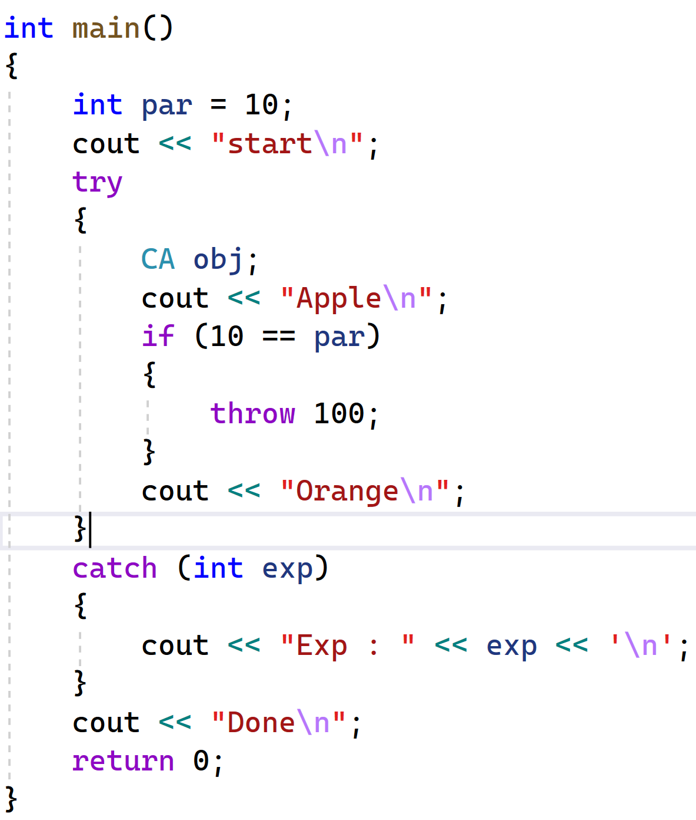
CatchTable
2. Stack unwinding
1. Exp copied to catch table
3. Exp sent to catch block
4. Release CatchTable

Slide 3
Process
stack
heap
DataSegment
CodeSegment
Obj2:CC
1111 CC::VFTable
vptr -> 1111
101 CC::fun1()
102 CC::fun2()
102

Slide 4
Process
stack
heap
DataSegment
CodeSegment
ca:CA
1111 CA::VFTable
vptr -> 1111
102
101 CA::f1
102 CA::f2
103 CA::f3
103
cb:CB
2222 CB::VFTable
201 CB::f4
vptr -> 2222
102
202
103
202 CB::f2
201
203 CB::f3

Slide 5
Process
stack
heap
DataSegment
CodeSegment
1111 IX::VFTable
102
101 IX::fx1
102 IX::fx2
px:IX*
10101
:CX
103
10101
VptrIX -> 3333
10105
VptrIY -> 4444
2222 IY::VFTable
201
201 IY::fy1
202 IY::fy2
py:IY*
202
10101
3333 CX::IX::VFTable
301 CX::fx1
302 CX::fx2
301
302
4444 CX::IY::VFTable
401 CX::fy1
402 CX::fy2
401
402

Slide 6
stack
heap
Sta
101
:int
:int
102
202
201
obj1
a
count
100
2
Obj1_2
a
count
101
201
Obj1_3
a
count
101
201
:int
102
:int
a
count
102
202
202
obj2
200
4
Obj2_2
a
count
102
202
Obj2_3
a
count
102
202
a
count
101
201
temp

Slide 7
heap
temp
101
*a=101
1000
obj
*a=102
102
1000

